Slide 1
Creating a COVIDSafe Summer
Helping Victorian businesses stay safe and stay open

Slide 2
AGENDA
COVIDSafe Summer
Update on face mask requirements
Stopping the complacency creep
Managing crowds
Electronic record keeping - QR codes
Public Events Framework
Cleaning requirements for businesses
Business showcase – your chance to share
Where can I get more information?
Q&A

Slide 3
Together we can keep our coast COVIDSafe this summer
Keeping our numbers low this summer means maintaining what already works to keep us safe.
After all, we’ve sacrificed so much.
Keeping Victoria safe this summer, is up to all of us.
Because when we Stay Safe we will all Stay Open.

Slide 4
Victoria’s COVIDSafe Summer - key changes to how we work
  Density limits in pubs, restaurants and cafes will shift to 1 person per 2sqm for both indoors and outdoors - with no other cap.
  In hospitality, the density of 1 person per 2sqm may be used so long as electronic record keeping is in place. If manual record keeping is used, the density limit is 1 person per 4sqm. For small operations, there are no density limits if the patron number is under 25.
  For retail and beauty services, businesses can move to 1 person per 2sq metres – if they also introduce electronic record keeping. For businesses where that is not possible, the density limits of 1 person per 4sqm will continue to apply.

Slide 5
Every business that is open must have a COVIDSafe Plan
This will help businesses to stay open and operate within current restrictions.
Having a COVIDSafe Plan built on the six COVIDSafe principles, continues to be a requirement:
    Ensure physical distancing
    Wear a face mask if physical distancing is not possible
    Practise good hygiene
    Keep records and act quickly if workers become unwell
    Avoid interactions in enclosed spaces
    Create workforce bubbles

Slide 6
COVIDSafe Summer
COVIDSafe Summer restrictions will be in place until at least the end of January.
Please help communicate these COVIDSafe messages to industry:
Every Victorian business that is open must have a COVIDSafe Plan
Continue to practise good hygiene and physical distancing
Keep records and act quickly if workers become unwell
Face masks are mandatory in some settings, and are recommended where you cannot
keep 1.5 metres distance from others
Move meetings and lunch breaks outdoors where possible
- Limit the number of people, workers are in close contact with where possible

Slide 7
Face mask requirements
Wearing a face mask is mandatory in some situations and are still important. They've helped us get to where we are now.
They are mandatory on public transport, in taxis or ride share vehicles, and must be worn by workers and customers in the following retail premises:
Stores and supermarkets that are 2000 square metres or larger
Shopping centres
Stores that are located in shopping centres
Indoor markets and market stalls
It is strongly recommended that you wear a face mask in all other settings where you cannot
keep 1.5 metres distance from others, but it is no longer mandatory.

Slide 8
Stopping the complacency creep
There is a surveillance and enforcement program.
Non-compliance themes, across different industries, include:
not following density requirements
not record keeping
lack of signage
lack of compliance with COVIDSafe Plans and
inadequate cleaning and hygiene procedures.
Notes:
Direct from the coronavirus website: "Directions will continue to be enforced through spot checks by Victoria Police and use of emergency powers by the Department of Health and Human Services Authorised Officers“
What can they do to help? And what resources do we have to give them? i.e. https://www.coronavirus.vic.gov.au/signs-posters-and-templates

Slide 9

Compliance checks
Checks of businesses are being conducted across Victoria by officers from DHHS, Worksafe, DJPR
and other government departments
Authorised officers will be in your area this summer checking businesses are complying with the restrictions

Slide 10
Managing crowds
Business are expected to implement COVIDSafe practises to keep staff, contractors and customers safe.
However, when large crowds of people congregate, and are not physically distancing in an indoor space, or in a common area, it can be difficult for a business to manage.
The responsible agency in these situations is Victoria Police.
Victoria Police can be contacted via 000 if there is a possible risk to public health.
Notes:
Refer here for more detail: https://www.coronavirus.vic.gov.au/face-masks

Slide 11
Electronic Record Keeping
Electronic record keeping is now required in some settings where the density limit of one person per two square metres
is applied, including:
Hospitality
Personal care and body art services
Real estate services
Accommodation
Tourism operators

Slide 12
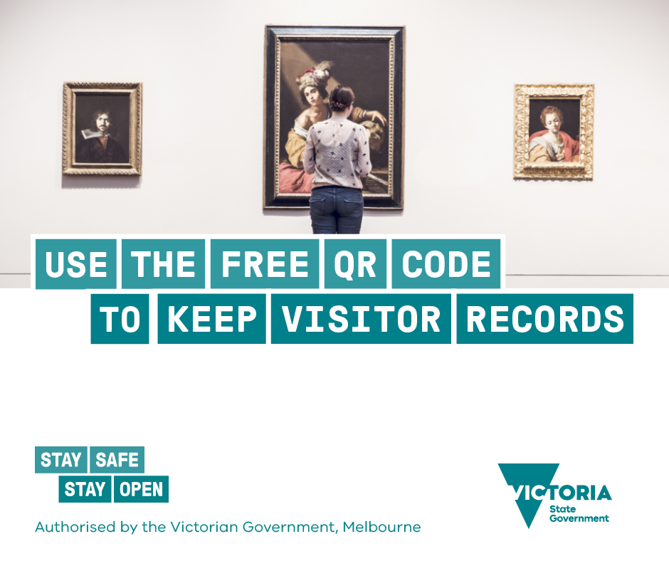
The Victorian Government QR Code Service
The Victorian Government QR Code Service is free for all Victorian businesses and venues.
These records help contact tracers in the event that a positive case of coronavirus (COVID-19) is identified.

Slide 13
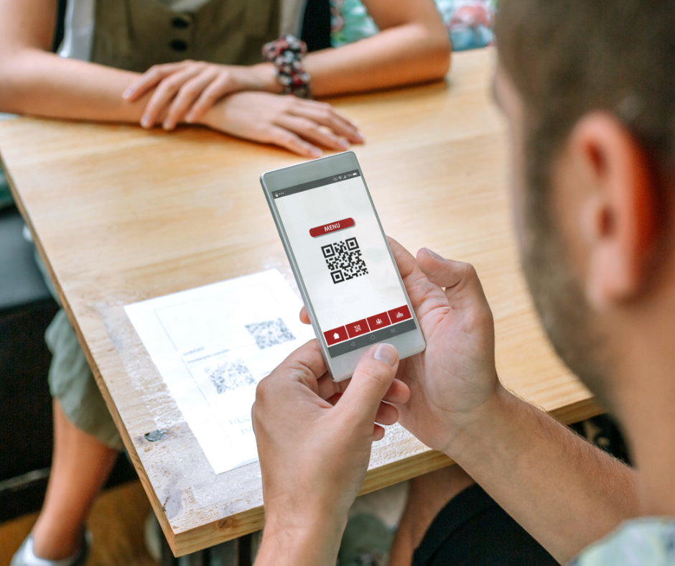
Using the Victorian Government’s new QR code service is easy.
Step 1: Register your business at coronavirus.vic.gov.au/qrcode
Step 2: Download, print and display your QR code
Step 3: Get customers to scan the code and check in.

Slide 14
How does it work?
QR codes operate like barcodes, using a smartphone camera to scan the unique code. Some phones may require a free QR code reader app, which is available from app stores.
Once customers scan the QR code they are directed to a web page to enter their contact details.
Their details are automatically saved on Service Victoria's secure servers, meaning businesses don’t have to collect and store the data themselves.

Slide 15
Why should I use the Victorian Government’s QR Code Service?
If a person who visited your business is later diagnosed with coronavirus (COVID-19), contact tracers can use this data to quickly contact everyone who may have been exposed. Data is only stored for 28 days and only accessed if there is a positive case.
The Victorian Government QR code service is free, secure and convenient but businesses may continue to use other QR code systems that meets the record keeping requirements.

Slide 16
Public Events Framework
The Public Events Framework allows for larger gatherings of people at public events.
The event organiser must seek approval from the Victorian Government and comply with the requirements.
A three-tiered system is used to ensure the appropriate level of public health oversight is applied to public events.
Tier 1: More than 5,000 attendees
Tier 2: Between 1000 to 5,000 attendees
Tier 3: Less than 1000 attendees
For more information:
https://www.coronavirus.vic.gov.au/public-events-information-for-organisers

Slide 17
Cleaning: Maintaining a hygienic and safe work environment
Employers must keep a record of all cleaners who attend a workplace for longer than 15 minutes
Employers must take reasonable steps to ensure that shared spaces and public areas are cleaned regularly.
Frequently touched surfaces must be cleaned at least twice a day when visibly soiled and immediately after a spill
Cleaning must happen between functions and groups
Cleaning must always use an anti-viral disinfectant

Slide 18
Business showcase
We would like to hear from businesses and peak bodies…
How have you kept people COVIDSafe?
Do you have suggestions for reducing the risk of workplace transmission?
Have you got ideas to share?

Slide 19
Where to get more information
Visit coronavirus.vic.gov.au/covidsafe-plan for templates and guidance on creating a COVIDSafe Plan for your small business.
For more information, visit coronavirus.vic.gov.au
or call the Business Victoria Hotline on 13 22 15
You can request a free translator by calling 13 22 15
Every Victorian business must have a COVIDSafe Plan.

